Slide 1
Drinking Water Treatment
A Basic Overview of Drinking Water Production

Slide 2
Why are we here
Because you are now a part of the “Multi-Barrier” approach to protect the community’s drinking water
The decisions you now make directly affects the entire community
We are all in this together, every operator must have the same basic knowledge to perform their job to the best of their ability

Slide 3
Why are we here
Typhoid fever cases per 100,000 population from 1890 to 1935, Philadelphia

Slide 4
What to expect during this training
This will be a quick overview of several pertinent topics to succeed as an intern
Topics will cover some of the content needed to pass an entry level certification exam
Everything discussed, including the math, will be relevant concepts to operating a drinking water treatment plant

Slide 5
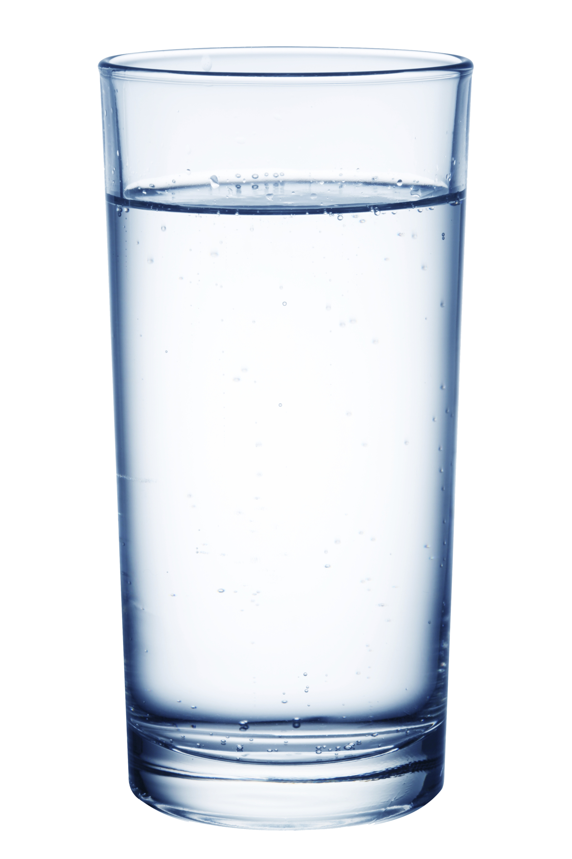
Group Discussion
Would you drink this glass of water?
Do you think this is safe to drink

Slide 6
What are the responsibilities of an operator?
Provide Clean, Safe drinking water to meet the system’s demands
Provide an aesthetically pleasing quality of water to the customers
Free of floating particles (turbidity) and palatable
Taste and Odors not present in the water

Slide 7
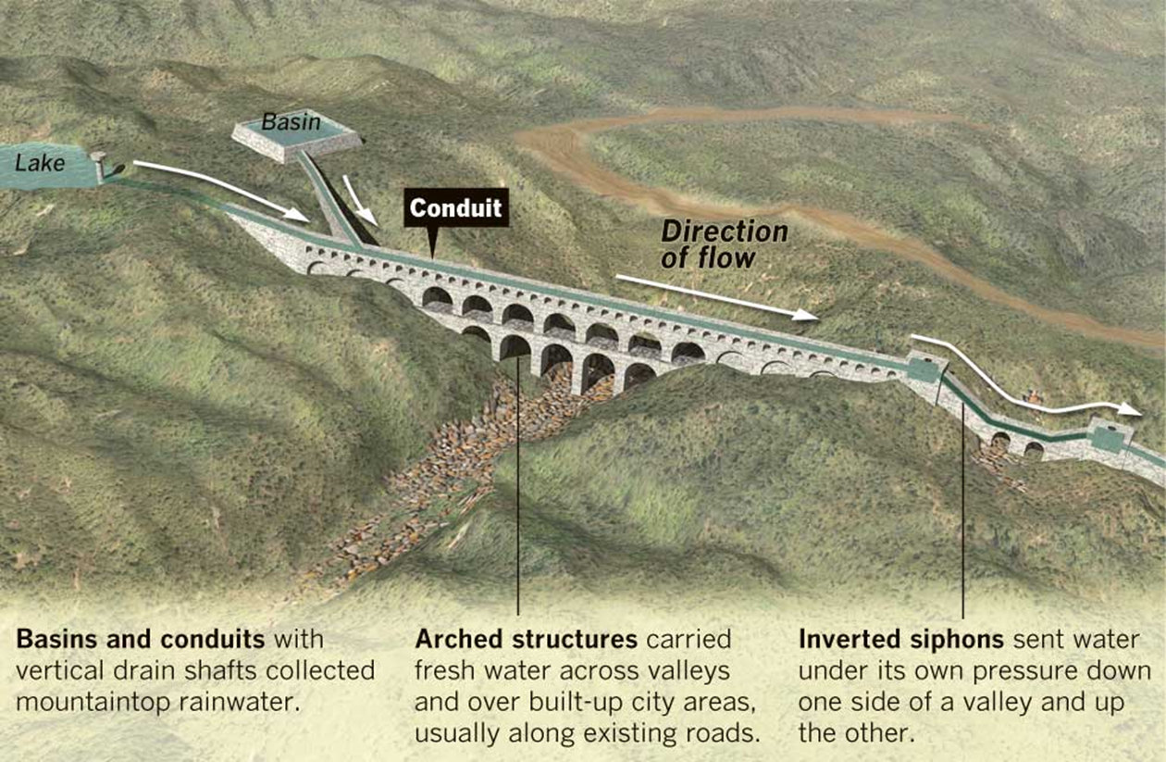
History
Evidence of water treatment dates back to approximately 4000 B.C. – over 6,000 years ago
Ninevah Aqueducts were built in Iraq between 703 and 690 B.C
Greece had pipes made of lead and bronze
Roman Empire had a series of aqueducts from 800 B.C. – 300 A.D. spanning 11 miles
Source: LA Times

Slide 8
Safe Drinking Water Act
Original Law passed in 1974
Required EPA to establish standards for systems serving ≥25 customers
Provided for Federal and State partnership
Established a procedure to protect groundwater

Slide 9
SDWA Continued
Reauthorized in 1986
Expanded the number of regulated contaminants
Established a monitoring program for unregulated contaminants
Limited the use of lead pipes and lead solder in new drinking water systems
Provides Primacy to State – meaning it is managed by the state but the state regulatory agency needs to meet minimal federal requirements.
In WV, this required disinfection for all public water systems
Required filtration for all surface water systems

Slide 10
SDWA continued
In 1996 it was reauthorized again..
This reauthorization required public transparency and reporting
Added source water assessments
Added Requirements for public notification of violation
Groundwater Rules

Slide 11
SDWA continued
Because the 1996 reauthorization required public transparency, your utility should have a consumer confidence report.
Try to locate your utility’s CCR report and analyze the information presented on it. Try to link how sampling and operational reports help populate the Consumer Confidence Report.

Slide 12
Figure 6-3 Number of Regulated Contaminants from 1976 through 2000

Slide 13
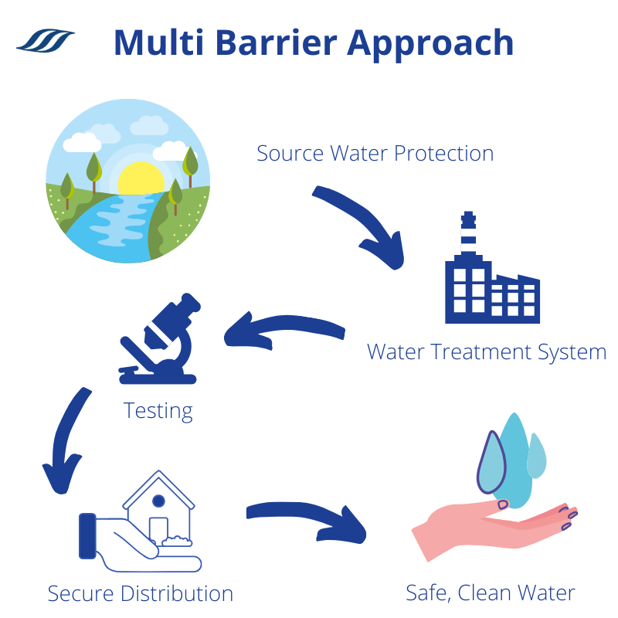
SDWA “Multibarrier Approach”
1. Assessing and Protecting Source Water
2. Making sure water is treated by qualified operators
3. Ensuring the integrity of the distribution system
4. Making information available to the public on the quality of their drinking water

Slide 14
SDWA: Overview
Primary Standards
Enforceable – based on health risks
EPA must balance risks with economic and technologic feasibility
Primary standards types:
MCL = maximum contaminant level
TT = treatment technique
Precursor to establishing a primary MCL: MCLG = maximum contaminant level goal
Secondary Standards
Not enforceable by federal government (but some states do) – based on issues of aesthetics (taste, odor, etc.) or other concerns (hardness)
Things like Aluminum
Notes:
https://www.youtube.com/watch?v=inLZwGZSvSc or a similar video
The MCLG for any carcinogen in 0, since any concentration of those compounds can lead to increased cancer risk.
BUT, disinfecting water with chlorine causes carcinogenic DBPs.
This is why SDWA amendments specify overall health risks must be minimized by balancing between competing risks.

Slide 15
Maximum Contaminant Level (MCL)
Maximum permissible level of a contaminant which is delivered to any user of a public water system
Set as close to MCLG as feasible

Slide 16
Maximum Contaminant Level Goal (MCLG)
Maximum level of a contaminant at which no known or anticipated adverse health effects occur with an adequate margin of safety
Non-Enforceable goals based on health effects only
Must be published for each contaminant for which an MCL or treatment technique is set

Slide 17
Key Takeaways MCL vs MCLG
MCL is set at a point there are no known health effects
MCLG is set “in a perfect world” that’s what we want it to be

Slide 18
Federal Regulations
The Federal Regulations for Public Water Systems can be found at:
40 CFR § 141 – National Primary Drinking Water Regulations
40 CFR § 142 – Implementation of the Public Water System Supervision Program
40 CFR § 143 – National Secondary Drinking Water Regulations

Slide 19
40 CFR § 141
National Primary Drinking Water Regulations
Set to protect public health
Contain Enforceable Regulations
Contain the MCLs and Requirements for monitoring and treatment

Slide 20
40 CFR § 142
Covers how States, Tribes, and the EPA implement the Public Water System Supervision Program (PWSS)
Provides for delegation to states or tribes with oversight of the EPA
Grants Primacy to state regulatory agencies (WVBPH/OEHS)
Provides for Federal Enforcement
Primacy can be revoked for not monitoring correctly

Slide 21
40 CFR § 143
The National Secondary Drinking Water Regulations
Contains Secondary MCLs (SMCLs)
Recommended Standards that relate to the acceptability of drinking water to consumers (Taste and Odor)
Not enforceable standards except for exceedance of fluoride SMCL

Slide 22
1
Over 90 primary standards!

Slide 23
4

Slide 24
What is a Public Water System?
Any water supply or system that regularly supplies or offers to supply water for human consumption
Water is served through pipes or other constructed conveyances
Must serve at least an average of twenty-five (25) individuals per day for at least sixty (60) days of the year OR has at least 15 service connections

Slide 25
Transient/Non-Transient – Community/Non-Community
Classification continues to get more specific. There are 4 different types of Public Water Systems used to describe the community is serves
Community Water System
Non-Community Water system
Non-Transient Non-Community system
Transient Non-Community System

Slide 26
Transient/Non-Transient – Community/Non-Community (continued)
Community Water System – A Public Water System that has at least fifteen (15) service connections or regularly serves 25 year round residents

Slide 27
Transient/Non-Transient – Community/Non-Community (continued)
Non-Community Water System – any public water system that is not a community system
There are two types of Non-Community Systems
Non-Transient Non-Community Systems
Transient Non-Community Systems

Slide 28
Transient/Non-Transient – Community/Non-Community (continued)
Non-Transient Non-Community
Regularly serves twenty-five (25) of the same people over 6 months per year
Schools, Universities, Large Industrial Complexes, etc.

Slide 29
Transient/Non-Transient – Community/Non-Community (continued)
Transient Non-Community Water System
Does not serve at least twenty-five (25) of the same people over six (6) months per year
Rest Areas, Campgrounds, Visitor Centers, Motorsport Complexes

Slide 30
Classification of Water Systems
There are four (4) basic main classifications to public water systems
Surface Water
Ground Water
Ground Water under the Direct Influence of Surface Water (GUDI)
Purchase/Consecutive system
Does not produce water

Slide 31
Classification of Water Systems (continued)
Surface Water System
Water which is open to the atmosphere and subject to surface runoff
Lakes, Reservoirs, Rivers, Creeks, Ponds
At minimum, Surface Water Plants are required to provide filtration

Slide 32
Classification of Water Systems (continued)
Groundwater system
Water located beneath the Earth’s surface, not exposed to open atmosphere
Typically Located in aquifers

Slide 33
Classification of Water Systems (continued)
Ground Water under the Direct Influence (GWUDI or GUDI)
Any Ground Water with:
Significant occurrence of insects or other microorganisms, algae, or pathogens
Significant changes in pH, Turbidity, or Conductivity that correlates to surface or climate changes
Examples include springs, and mines
This water is treated in the same fashion as surface water

Slide 34
Classification of Water Systems (continued)
Purchase/consecutive Systems
A Public Water System that purchases all it’s potable water from another public water system for the purpose of resale.
These types of systems do not have a treatment process

Slide 35
Record Keeping
Length to be kept | Record to be kept
2 Years | Copies of Backflow Test results
3 Years | Copies of Public Notices; Actions to correct violations
5 Years | Monthly Operational reports, Bac-T analyses, Records for a variance or exemption.
10 Years | Radiological, Chemical, and Turbidity analyses; Copies of written reports, summaries, or communications regarding sanitary surveys
12 Years | Lead and Copper Analysis
Indefinitely | Copies of CT/log inactivation calculations

Slide 36
What do you think happens at a water treatment plant?
Group Discussion: What processes are you aware of in a Drinking Water Treatment Plant?

Slide 37
It depends...

Slide 38
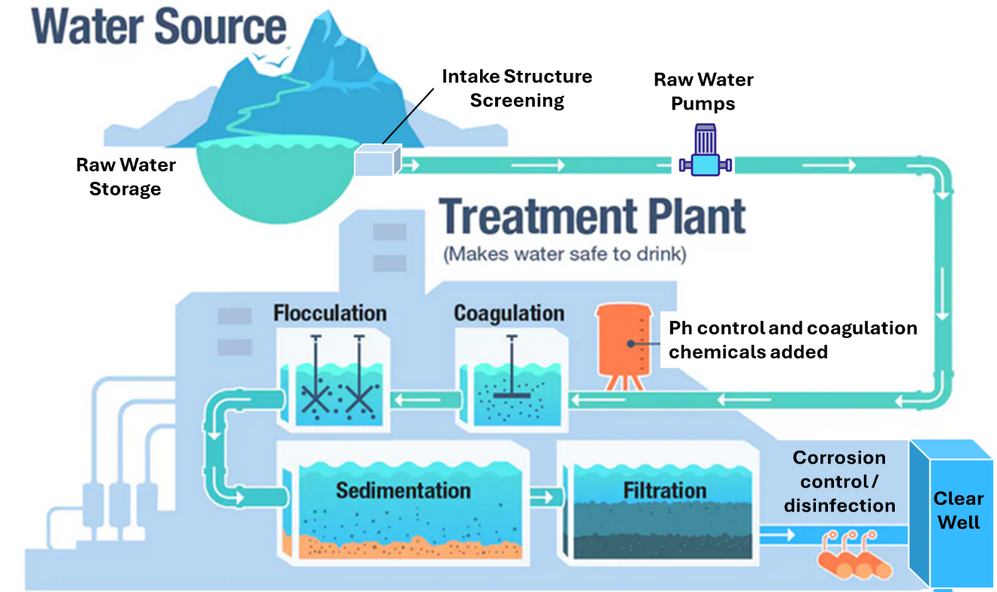

Slide 39
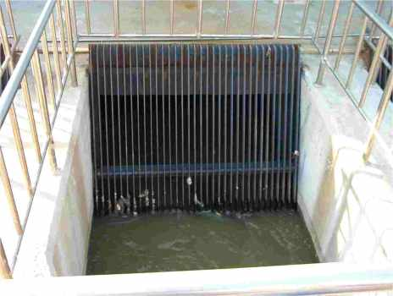
Screening
Water flows through meshes/filters with relatively large aperture sizes
Removes large debris, such as sticks, leaves, and litter
This is the first round of clarification and also serves to protect subsequent equipment

Slide 40
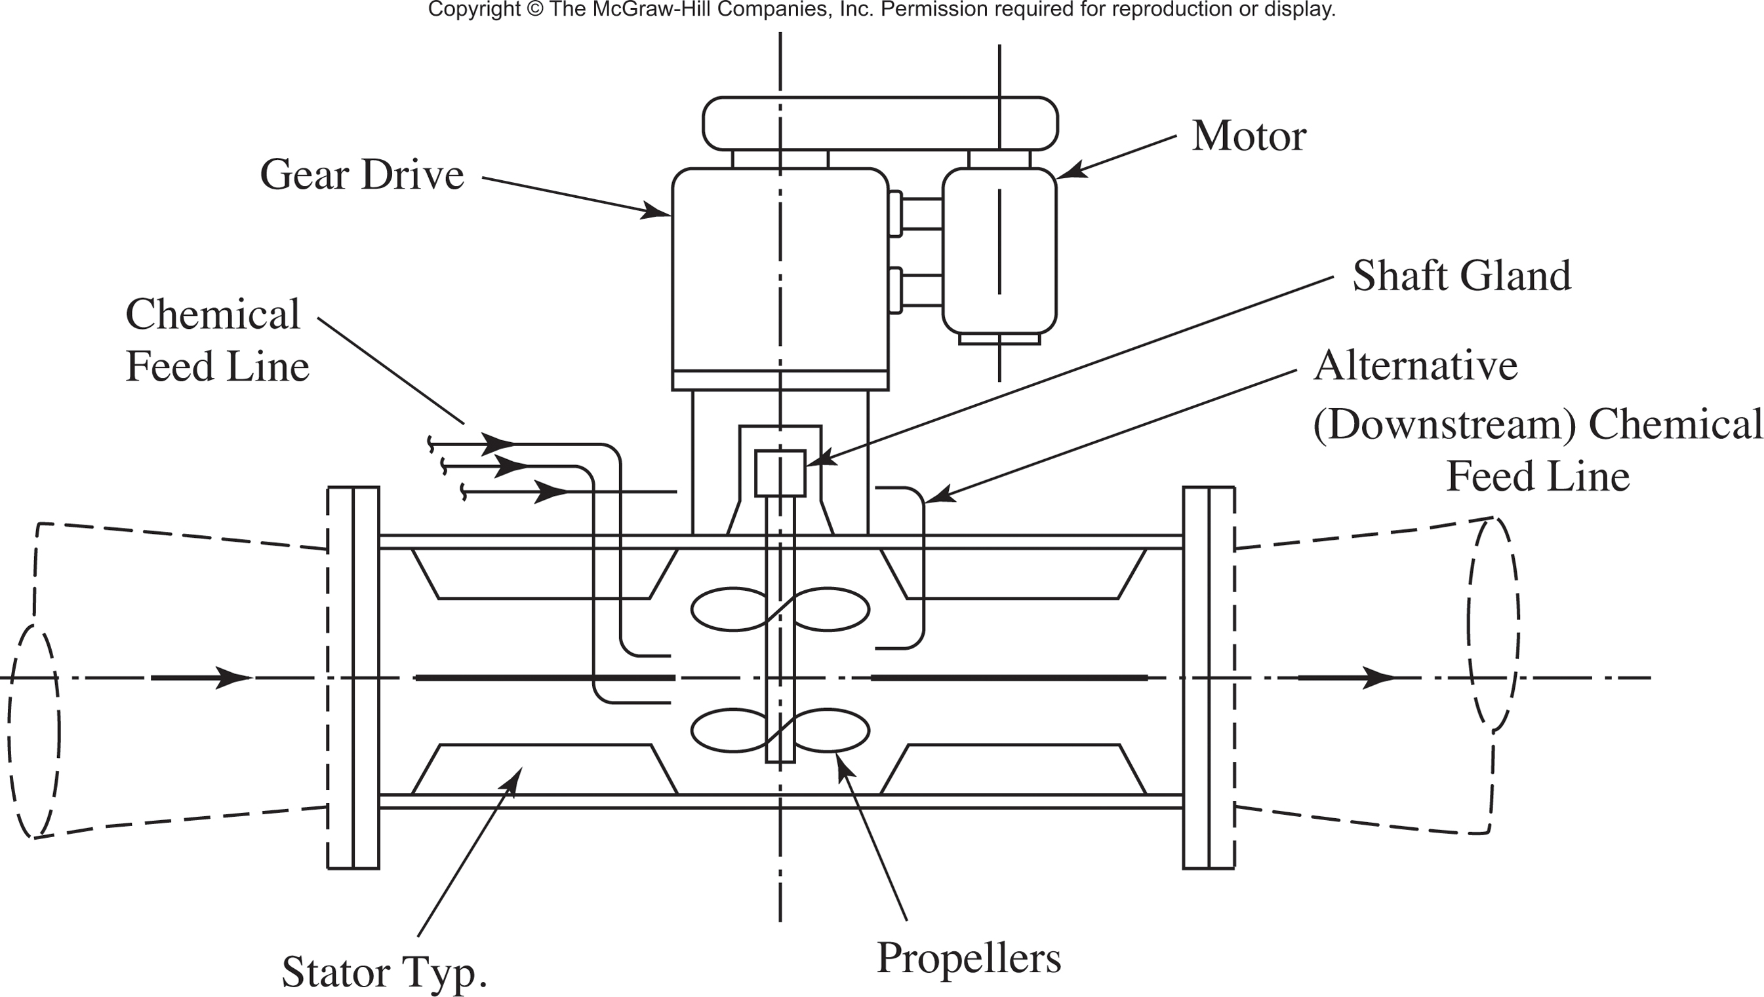
Coagulation
Chemicals known as coagulants (such as Aluminum Sulfate (alum), Poly-Aluminum Chloride (Del-PAC), or Ferric Chloride) are added to the water. This process uses an electrical charge that naturally occurs on the floating particles. Once that Charge reaches Net-Zero they bind together creating large formations known as Floc
Coagulants are dosed using a rapid mix/flash mix basin or inline mixer
Inline Mixer

Slide 41
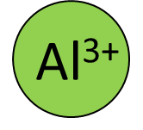
Coagulation
Particles naturally occurring in the water have a negative surface charge.
Aluminum Sulfate
When the aluminum sulfate coagulant is dosed, it releases positively charged aluminum ions.
The aluminum ions help the negatively-charged particles to stick together, forming larger and heavier flocs that will settle to the bottom of the tank.

Slide 42
Coagulation
Particles naturally occurring in the water have a negative surface charge.
Aluminum Sulfate
When the aluminum sulfate coagulant is dosed, it releases positively charged aluminum ions.
The aluminum ions help the negatively-charged particles to stick together, forming larger and heavier flocs that will settle to the bottom of the tank.

Slide 43
Coagulation
Particles naturally occurring in the water have a negative surface charge.
Aluminum Sulfate
When the aluminum sulfate coagulant is dosed, it releases positively charged aluminum ions.
The aluminum ions help the negatively-charged particles to stick together, forming larger and heavier flocs that will settle to the bottom of the tank.

Slide 44
Flocculation
After the coagulant is added, the water is then mixed in a very slow and steady pattern. This allows the particles to clump together forming large flocs. These larger clusters of particles then become heavy and head to the sedimentation basin. This process is done in a slow fashion as to not break apart the newly created formations

Slide 45
Sedimentation
These flocs travel across the sedimentation basin. Due to the weight from being clumped together, they begin settling into the lower portions of the basin. This process allows filters to run longer, have less stress, and allowing you to operate longer without the need for a backwash in the filters.

Slide 46
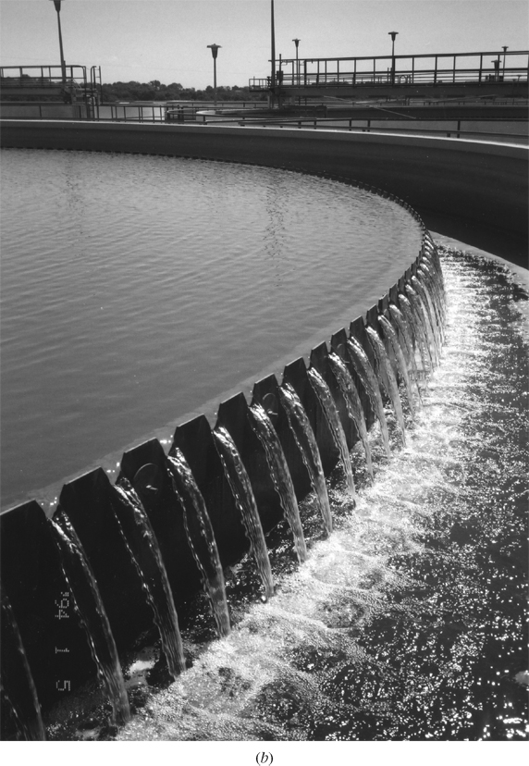
Sedimentation

Slide 47
Sedimentation
Source: Small Water System Operation and Management, Office of Water Programs.

Slide 48
Coagulation, Flocculation, and Sedimentation
Goal: Remove small particles
Coagulant
Rapid Mix
Flocculation
Sedimentation

Slide 49
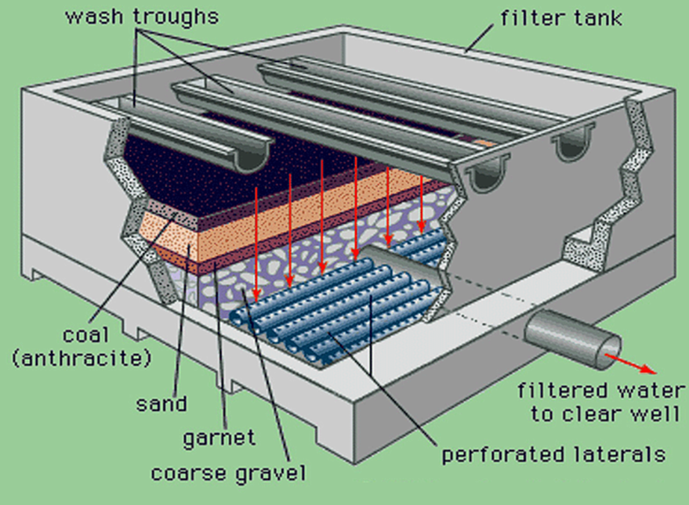
Filtration
The cleaner water is then pumped from the end of the sedimentation basin to the top of filters. These filters then use gravity to allow the water to travel down through the media inside. This media removes all types of contamination such as silt, microscopic organisms, organic material, etc.

Slide 50
Filtration

Slide 51
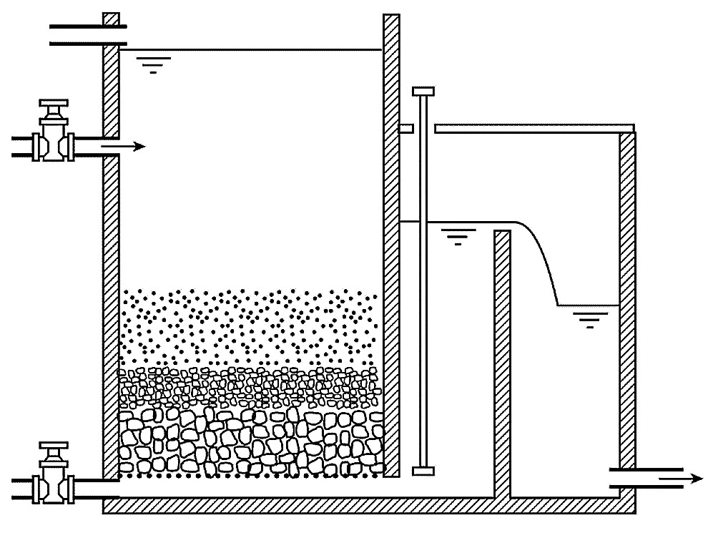
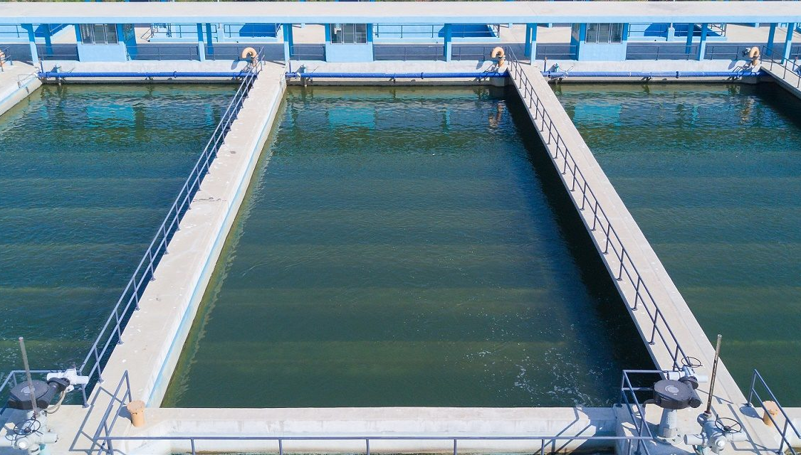
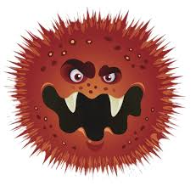
Filtration
Goal: Remove small particles and harmful microorganisms

Slide 52
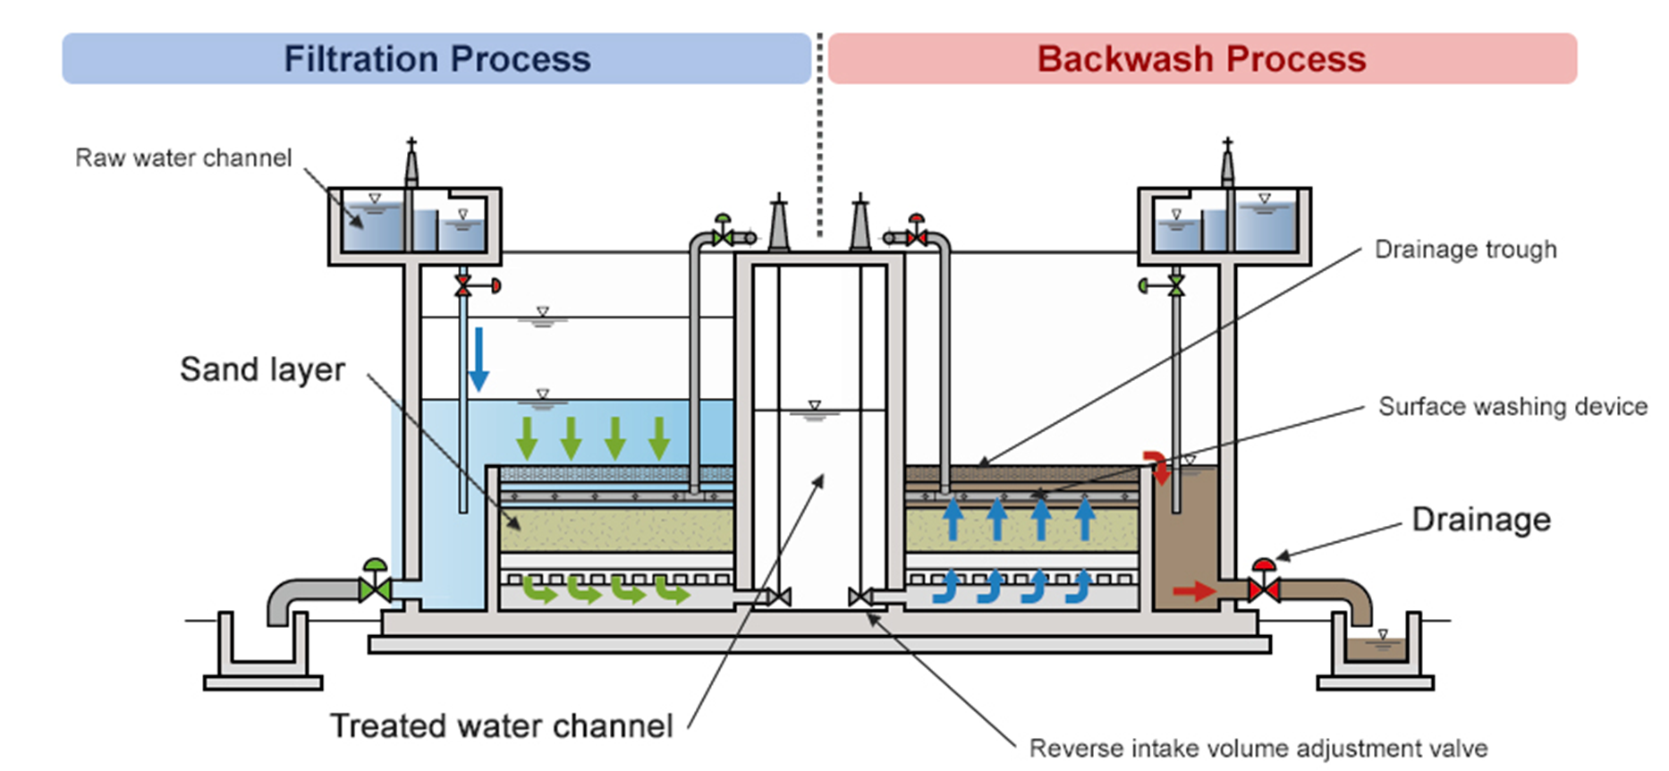
Backwashing
Process of reversing the flow of water through the filter media to remove entrapped solids
Notes:
https://www.youtube.com/watch?v=UmzR3TRTz2U

Slide 53
Backwashing Video
Backwashing Video - Youtube

Slide 54
Group Discussion
With the knowledge presented in the previous slides, what do you think we must still do with the water after the filters?

Slide 55
Disinfection

Slide 56
Disinfection
After being ran through the filter, free chlorine is greatly reduced. This is caused by natural oxidization of metals in the sed basin, reaction with microorganisms, or even the carbon in the filter itself. Therefore, we must bump the chlorine residual back up to ensure that the water in the distribution system has sufficient residual and can ensure we have deactivated all the microorganisms in the water.
Water is then transferred to finished water storage where High-Service Pumps transfer it to the distribution system

Slide 57
Disinfection By-products

Slide 59
Disinfection/Chlorination
At the plant, we measure FREE Chlorine
Free Chlorine is the amount of chlorine readily available to disinfect bacteria or other contaminants in the water
In the Distribution system, we measure TOTAL chlorine
Total chlorine is the combination of free chlorine and combined chlorine (Chloramines)

Slide 60
Breakpoint Chlorination
Breakpoint chlorination is the point at which enough chlorine has been added to water to satisfy its disinfection demand
A threshold where free chlorine exceeds levels needed to satisfy disinfection requirements
Once breakpoint is reached, you begin developing a free chlorine residual

Slide 61
Breakpoint Chlorination

Slide 62
Breakpoint Chlorination
How do we determine how much chlorine to add?
Chlorine Dose = Chlorine demand (mg/L) + Chlorine residual (mg/L)
We will first determine what we want our desired residual to be.
Chlorine residual in the Distribution system cannot be less than 0.2 or higher than 4
Be mindful of this when determining where to set chlorine dose as to not have residual at the farther points in the system

Slide 63
Disinfection Requirements
Groundwater systems are to provide a 4-log inactivation (99.99 %)
Surface water and GUDI systems are to provide:
A 3-log giardia inactivation or removal
A 4-log virus inactivation or removal

Slide 64
0.6%
0.8%
0.9%
97.2%
0.4%
0.1%
Chronic effects are not represented here!
Notes:
This doesn’t mean we only care about parasites – chemicals can have chronic impacts rather than acute outbreak conditions

Slide 65
Groundwater Treatment
Disinfection
Iron and Manganese Control (if needed)
Softening (if needed)

Slide 66
Water Treatment Overview
Water Treatment is using process controls to remove desired contaminants
To efficiently operate a plant, you must know what contaminants are present, and how concentrated is the contamination?
(ie. Are we oxidizing .78 mg/L of Iron or 1.57 mg/L?)

Slide 67
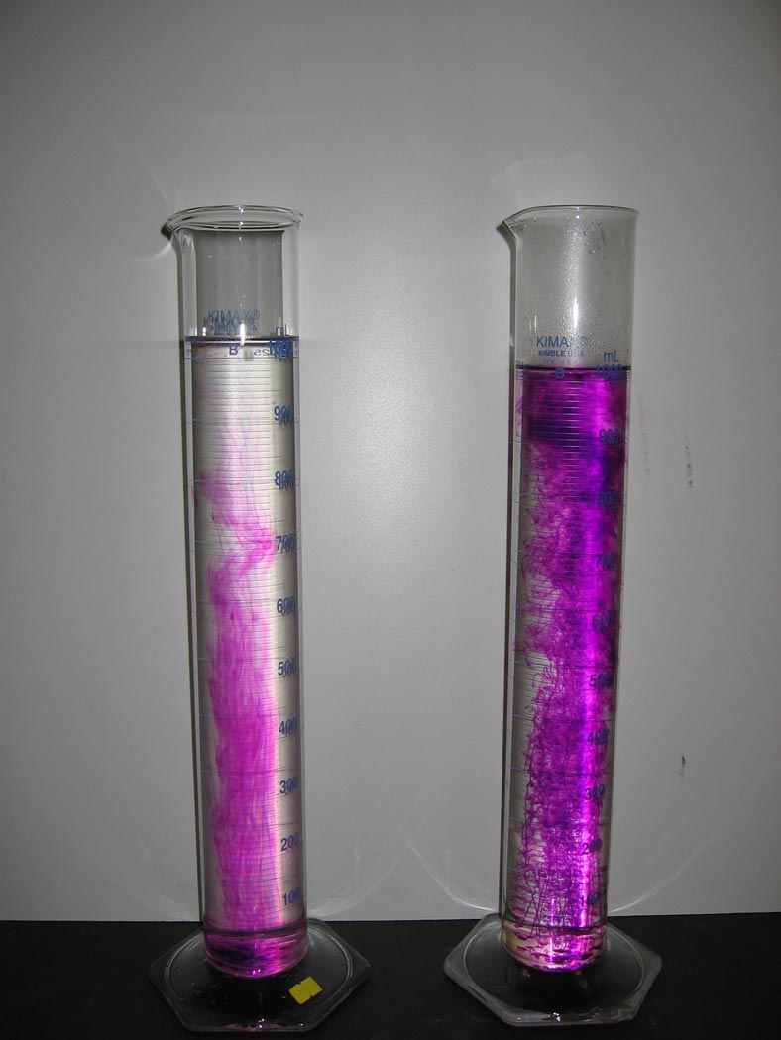
Water Treatment Overview (continued)
Once we have sampled our source water, and know what treatment processes are needed to treat the water, we can pump it into our plant
At the first stage, our goal is to add coagulant, and an oxidizer if necessary
Sodium or Potassium Permanganate is the first chemical added, to give soluble metals more time to oxidize in the sedimentation basins

Slide 68
Water Treatment Overview (continued)
We have added permanganate, and a coagulant. Now what?
Our chemicals are added, now the water goes through a “Flash Mix” which will combine the chemicals and raw water together and be delivered to the beginning of the sedimentation basin
Along with permanganate, some plants add chlorine with the coagulant in a Pre-Chlorine process
This help oxidization, and provides chlorine contact time across the sed basins
Chlorine is to be added AFTER permanganate as the two counter each-other

Slide 69
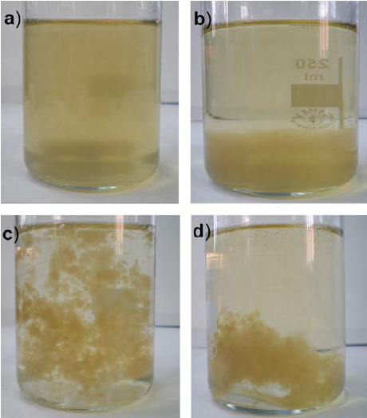
Water Treatment Overview (continued)
The water, now mixed, now travels across the sedimentation basins slowly
The coagulant binds the floating particles together to form “FLOC”
Combined into Floc, the particles become less buoyant and settle down into the bottom of the sedimentation basin
Water at the end of the sedimentation basins is commonly referred to as “Settled Water”

Slide 70
Water Treatment Overview (continued)
Settled water is transferred either by gravity or the use of intermediate pumps to the filter location
Settled water, now with much less turbidity is sent through the filter via gravity
The resulting turbidity effluent of the filters should never exceed .300 NTU

Slide 71
Water Treatment Overview (continued)
After the filters, the water is chlorinated again to the desired system concentration to achieve disinfection/inactivation AND maintain a residual in the system of greater than 0.2 mg/L
Sequestering agents are added post-filter as well to keep soluble metals in solution out in the distribution system
Post-Filter the water heads to the clear-well otherwise known as “Finished Water Storage”

Slide 72
Water Treatment Overview (continued)
Finished water storage allows time for the post filter chlorination to work with the water.
This process further allows contact time for pathogen/microorganism inactivation
Finished water is then pumped to tanks in the distribution system to be sold to customers

Slide 73
Water Treatment
Water Treatment in its most basic form is chemistry and process control
We also run tests throughout the process
We run laboratory tests to see:
What is in our Raw Water
What is in our finished water
How efficient is our settled water process

Slide 74
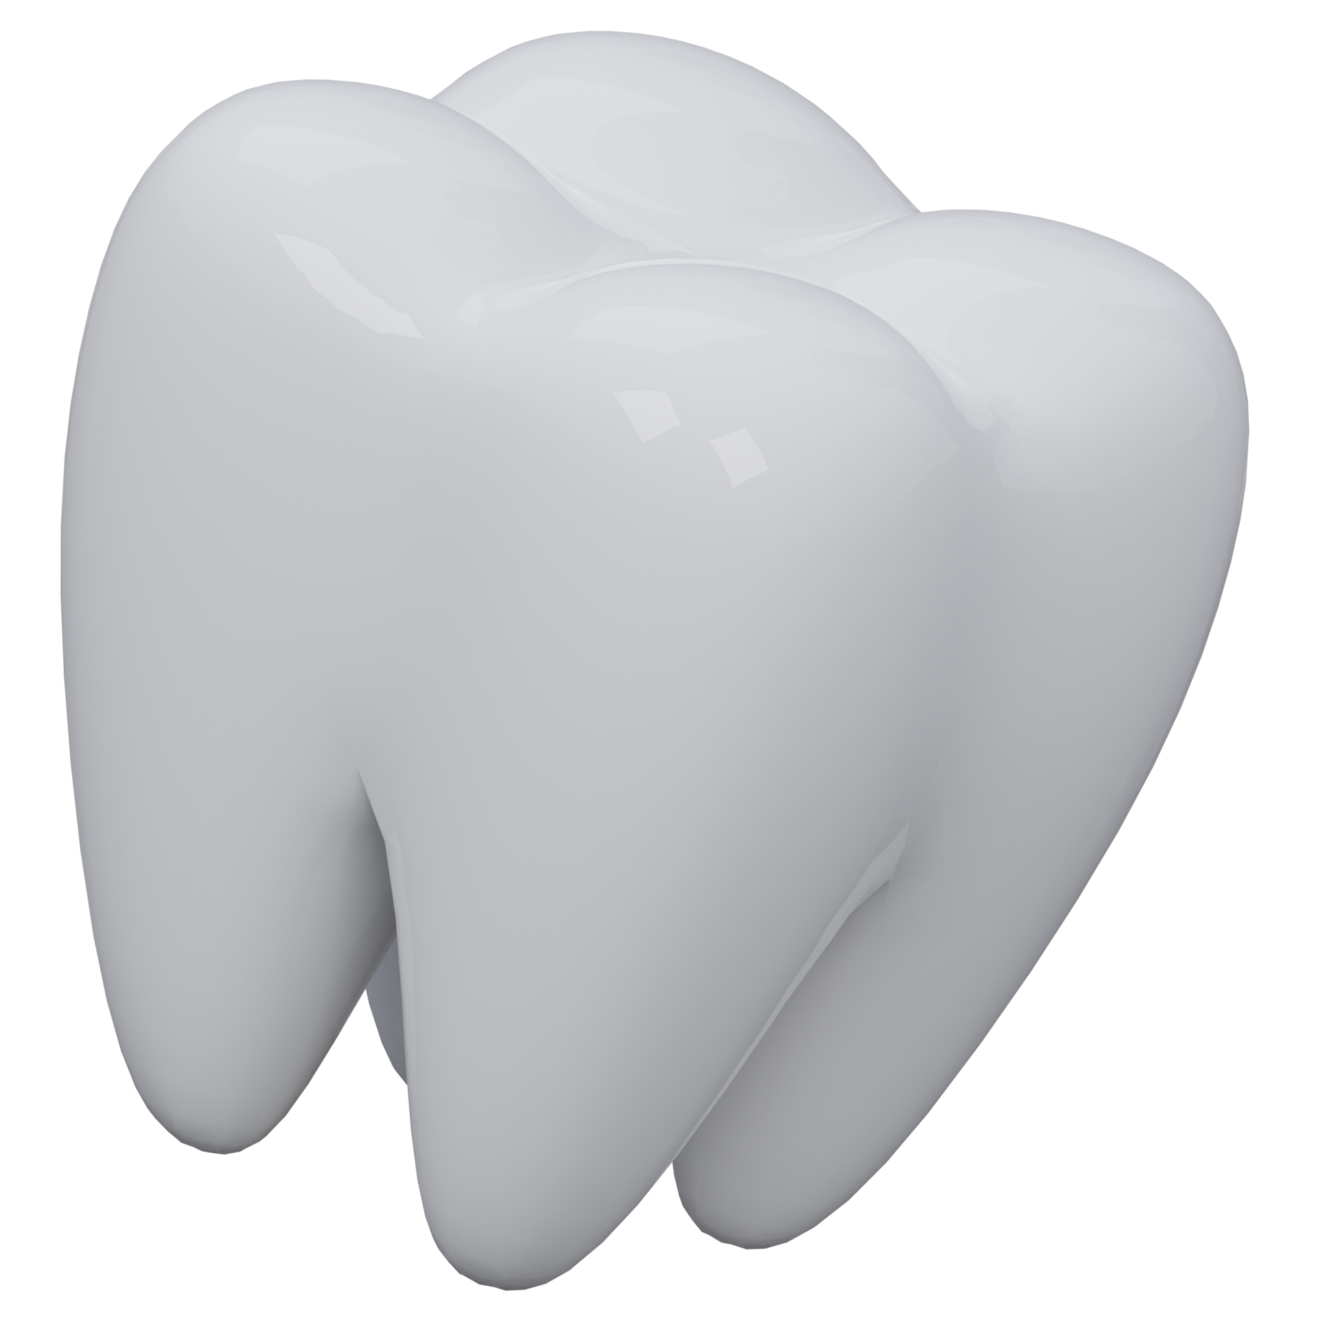
Fluoridation
Fluoride should be monitored at least once per day
Shall be no less than 0.5 mg/L and no higher than 0.9 mg/L
Optimum levels for fluoride are 0.7 mg/L

Slide 75
Stepping Back to the Intake
How do we determine how much of one chemical to add?
What do we sample for in the Raw Water?

Slide 76
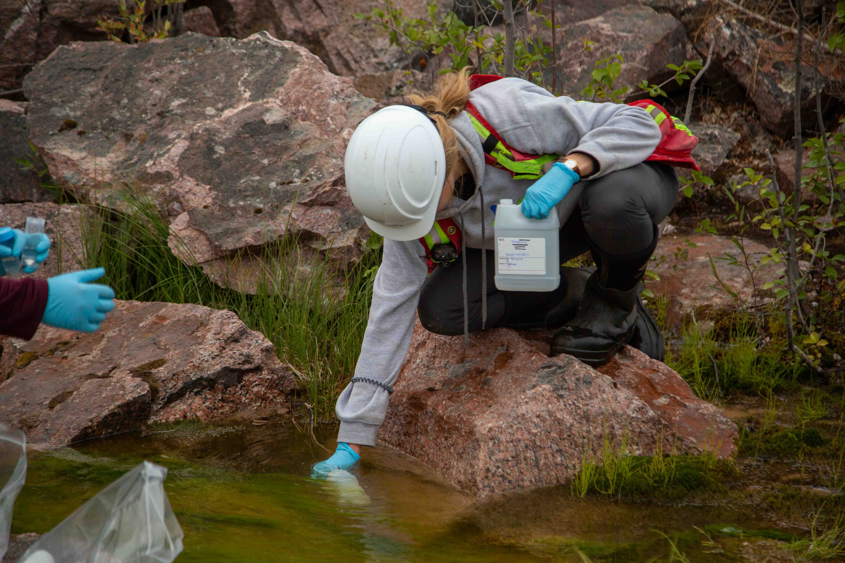
Stepping Back to the Intake
Typically in raw water, samples tested for in-house are
Raw Iron
Raw Manganese
Raw Alkalinity
Raw Hardness
Turbidity
Temperature
Raw PH

Slide 77
Stepping Back to the Intake
By sampling:
Raw Iron and Manganese will tell us how much oxidizer needs to be added
Raw alkalinity and temperature will tell us how well the water will react to our chemical additives
Raw Turbidity tells us how much coagulant to add to achieve less than .300 NTU post filter

Slide 78
Permanganate Dosage Problem
Permanganate Dose = Iron Concentration (mg/L) + 2x Manganese Concentration (mg/L)
Example: Raw water sampling has shown a raw iron concentration of .82 mg/L and a raw manganese concentration of .078 mg/L what should the permanganate dose be?

Slide 79
Permanganate Dosage Problem Solution
Fe - .82 mg/L
Mn - .078 mg/L
Remember PEMDAS?
2 * .078 = .156
.82+.156 = 0.976 mg/L
The Answer is approximately 1 ppm of permanganate.

Slide 80
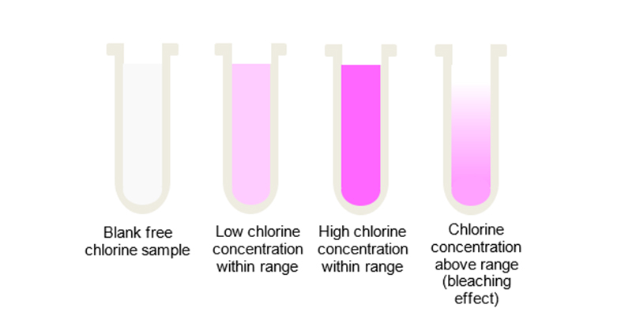
Chlorine Testing Equipment
You may only use approved testing methods from your state primacy agency
Chlorine testing equipment should be accurate to the nearest 0.2 mg/L
The EPA recommends using DPD colorimetric test kits for chlorine, chloramines, and chlorine dioxide

Slide 81
Practice Question
Disinfection requirements are specified as CT values (concentration x exposure time). If a CT of 150 mg-min/L is required, what chlorine concentration is needed for an exposure time of 1 hour (60 minutes).

Slide 82
Solution Work Through
Disinfection requirements are specified as CT values (concentration x exposure time). If a CT of 150 mg-min/L is required, what chlorine concentration is needed for an exposure time of 1 hour (60 minutes).
Solution:
$$CT=Concentration \left[\frac{mg}{L}\right]× Time [minutes]$$
One hour is 60 minutes.
$$150\frac{\text{mg}\text{−}\text{min}}{L}=Concentration ×\left(60 minutes\right)$$
$$Concentration \left[\frac{mg}{L}\right]=\frac{150 \text{mg}\text{−}\text{min}/L}{60 minutes}$$
$$Concentration=2.5 mg/L$$

Slide 83
Break Time
10-minute break for bathroom and stretch legs

Slide 84
Types of sampling
There are three (3) basic types of samples taken in drinking water production
Representative
Grab
Composite

Slide 85
Representative Sample
Representative samples: a portion of material or water that is as nearly identical in content and consistency as possible to that in the larger body of material or water being sampled
Examples:
Tap Sampling: flushing the lines to get a sample representative of that in the water main
Open Waters: sampling as close to the middle of the body of water as feasible

Slide 86
Grab Sample
Grab Sample : a single sample collected at a particular time and place which represents the composition of the water at that time and place
Examples:
Total/Free chlorine test, Bacterial Samples, Fluoride Samples

Slide 87
Composite Samples
Composite Sample: A composite sample is a collection of individual samples obtained at regular intervals (Usually every one or two [1-2] hours during a twenty four (24) hour time span. Each individual sample is combined with the others in proportional rates to the rate of flow when the sample was collected.
This method is used to determine AVERAGE conditions during the sampling period

Slide 88
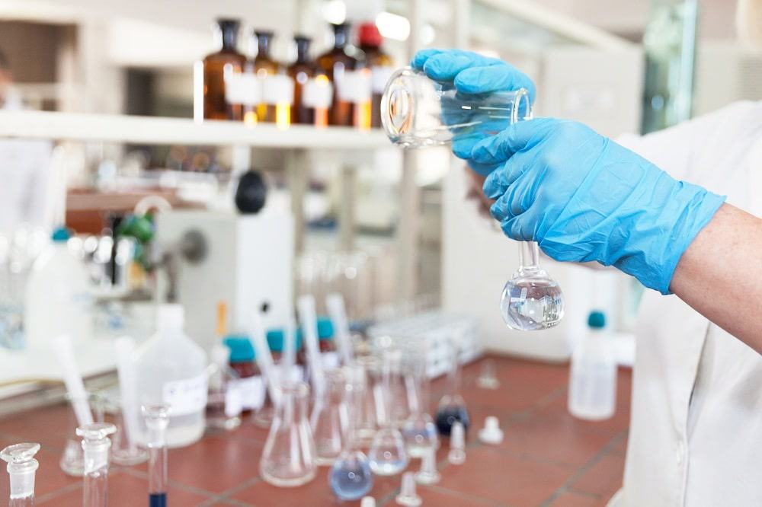
Laboratory Testing
Laboratory Testing is the #1 tool you have at your disposal to ENSURE you are producing clean safe drinking water
Sampling incorrectly or not following proper procedures is as bad if not WORSE than no testing at all

Slide 89
Laboratory Testing (continued)
What are we testing for in a water plant? Typically we are looking at:
PH
Turbidity
Alkalinity
Hardness
Temperature
Iron
Manganese
Disinfectant Residual
Fluoride

Slide 90
Laboratory Testing (continued)
How to we run samples?
Typically:
You will take a GRAB sample from set points in the water treatment plant. These areas include but are not limited to:
Intake
Beginning of Sedimentation Basins
End of Sedimentation Basins
Top of the filters
Post filtration

Slide 91
Laboratory Testing (continued)
From the raw water/intake, common testing conducted includes but is not limited to:
Ph
Alkalinity
Iron
Manganese
Hardness
Turbidity
By knowing these concentrations, we can accurately dose our water for appropriate floc formation in the sedimentation basins

Slide 92
Laboratory Testing (continued)
At the beginning of the sedimentation basins common testing conducted includes but is not limited to :
Disinfection Residual
Turbidity
PH
Alkalinity
This will give us indications about whether we are reaching breakpoint, a baseline to ensure sedimentation process is working, and PH and Alkalinity directly affect how well the coagulant is going to work.

Slide 93
Laboratory Testing (continued)
At the end of the sedimentation basins common testing conducted includes but is not limited to
PH
Turbidity
Disinfectant Residual
By sampling our turbidity at the end of the process we can ensure we are settling solids. We also want to ensure we have some sort of disinfectant residual before heading to the filters. This ensures that we are not below the demand needed for our water.

Slide 94
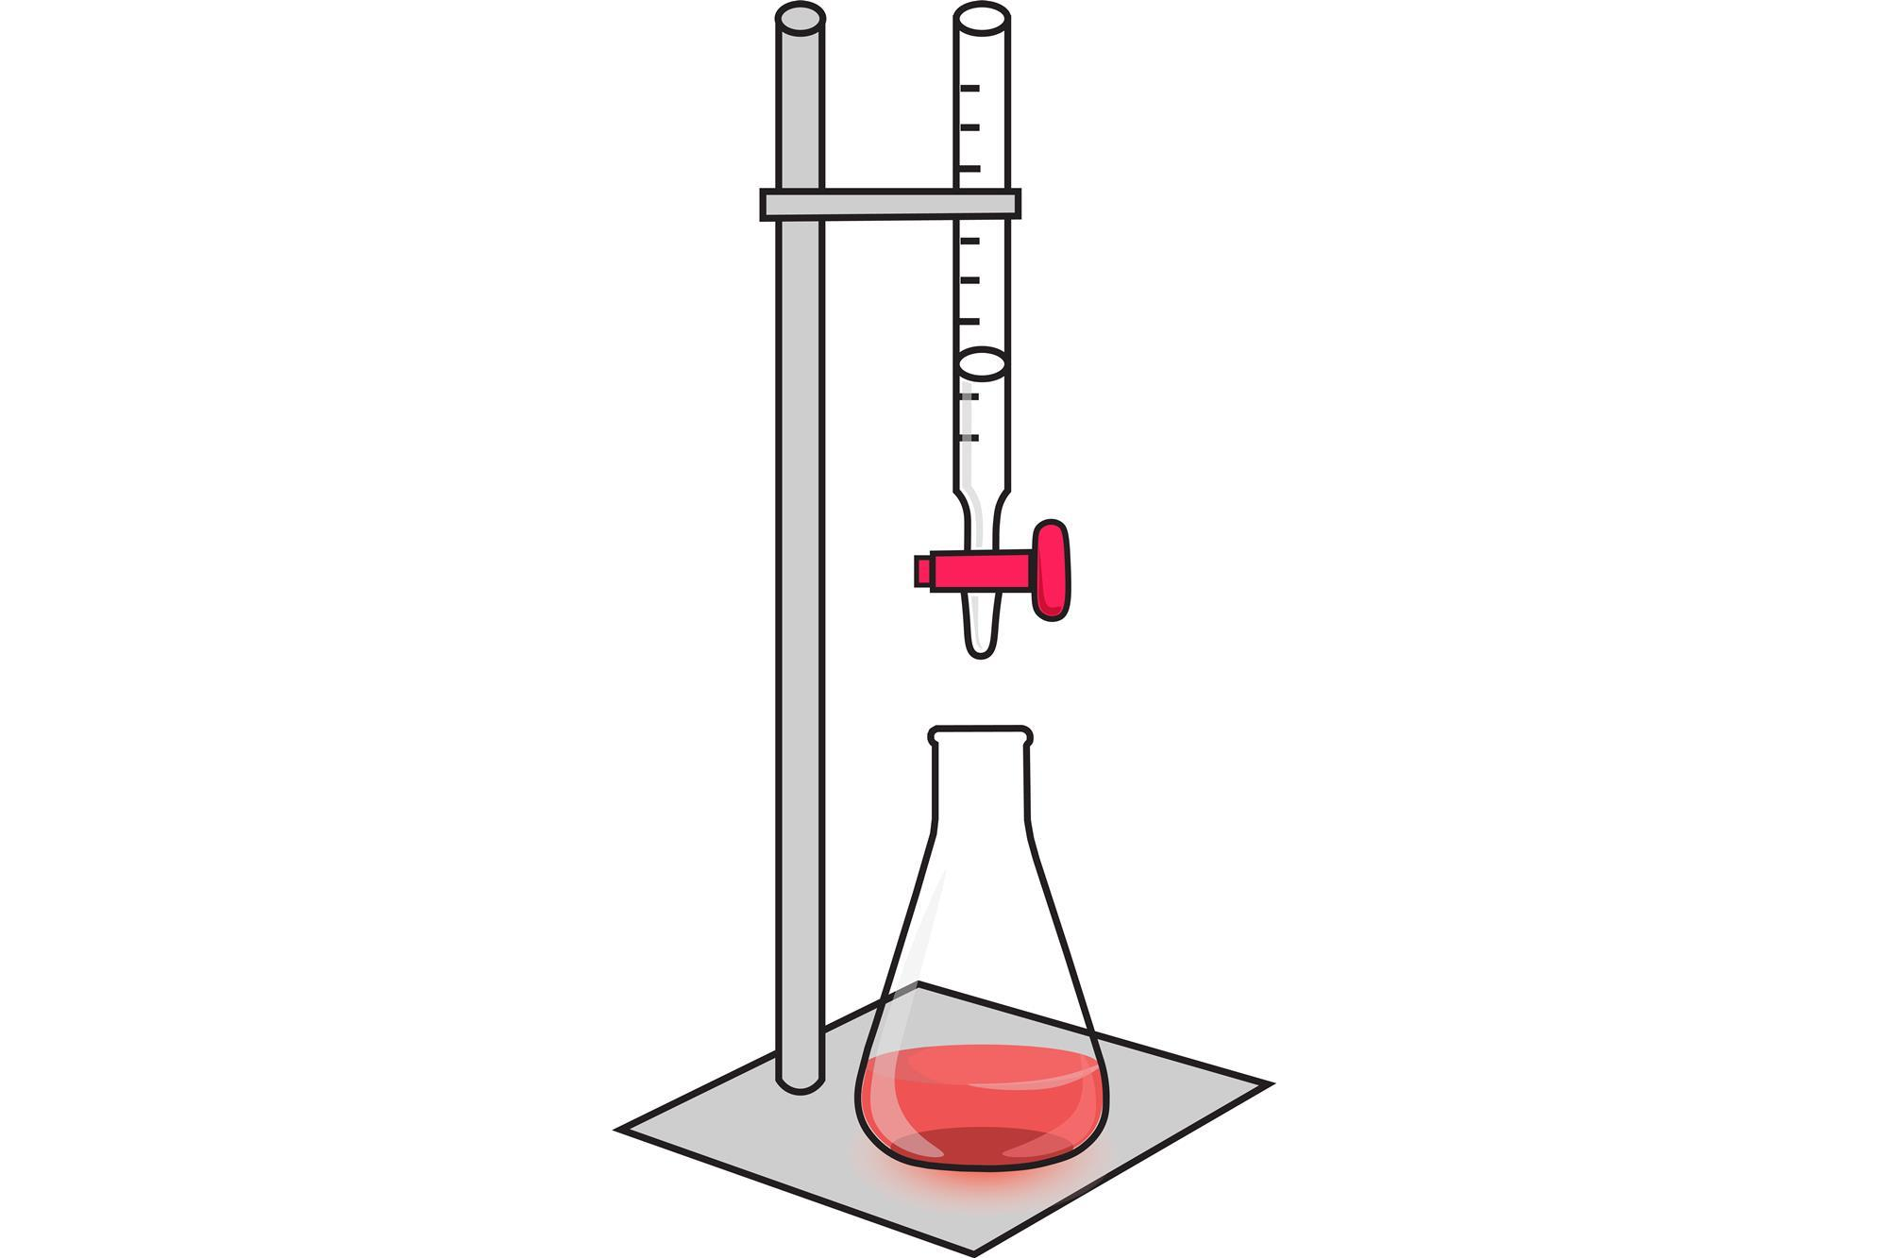
Laboratory Testing (continued)
On top of the filters most commonly we are measuring Phenolphthalein Alkalinity. This is a measure of how much acid it takes to reduce PH to a measure of 8.3 which is indicated through titration turning the sample from pink to clear.
Water with a PH greater than 8.3 is considered to have phenolphthalein alkalinity due to the presence of carbonate or hydroxide ions.

Slide 95
Laboratory Testing (continued)
Post-Filtration common testing conducted includes but is not limited to:
PH
Turbidity
Alkalinity
Hardness
Iron
Manganese
Fluoride
Disinfectant Residual
Because the water is now considered “finished” you must test to ensure the water falls within the MCLs and MCLGs for drinking water established by your state primacy agency

Slide 96
Math Problem
PH is measured on 9 consecutive days to be the following:
7.2, 7.1, 7.0, 7.3, 7.1, 7.0, 7.1, 7.0, 7.0.
What is the median pH measurement? What is the mode?

Slide 97
Math Problem Solution
pH is measured on 9 consecutive days to be the following: 7.2, 7.1, 7.0, 7.3, 7.1, 7.0, 7.1, 7.0, 7.0. What is the median pH measurement? What is the mode?
Solution:
Put the pH values in order of values from smallest to largest:
$7.0, 7.0, 7.0, 7.0, 7.1, 7.1, 7.1, 7.2, 7.3$
The median is the middle value in the order:
$7.0, 7.0, 7.0, 7.0, 7.1, 7.1, 7.1, 7.2, 7.3$
Therefore, the median is 7.1.
The mode is the value that appears most often:
$7.0, 7.0, 7.0, 7.0, 7.1, 7.1, 7.1, 7.2, 7.3$
7.0 appears four times, 7.1 appears three times and the other values appear once.
Which means, the mode is 7.0.

Slide 98
Laboratory Equipment
What Items should be found in the lab?
Beakers
Volumetric Flasks
Graduated Cylinders
Pipets – either disposable or non-disposable
Burets for Titration
Pipet Bulbs
Crucibles
Funnels
Thermometers
Distilled Water
Deionized Water
Sample Cells
Reagents for testing
Spectrophotometer

Slide 99
Reading Glassware Volume Measurements
A Graduated Cylinder is a long slender vessel used for measuring volumes of liquid.
A Beaker is a cylindrical laboratory container with a flat bottom and a tiny spout for pouring that is perfect for handling liquids in experimental configurations.
There is a curved surface on the top of the column of liquid. This slope is known as the meniscus, and is vital to accurately recording your measurement

Slide 100
Reading Glassware Volume
Here is an example of a meniscus in a graduated cylinder, what is the volume in this example with the assumption this is in ml

Slide 101
Pipettes

Slide 102
Pipettes
A pipette is a lab device used to measure out or dispense small amounts of liquid in volumes of milliliters or microliters
Typically, in water treatment you will be measuring in mL

Slide 103
Crucible for Titration
Crucibles are sometimes used for titration
When titrating, you would take a predetermined measure of a volume of water and pour into the dish.
Following the liquid, a reagent such as methyl-orange will be added and used to titrate the water to determine alkalinity

Slide 104
Titration Burette
The burette labeled to the right is a laboratory instrument designed for the accurate dispensing of small volumes of liquid or gases. It consists of a long, graduated glass tube equipped with a valve, typically located at one end, allowing precise control of the liquid flow

Slide 105
Sample Cells
Sample cells are a small, transparent container used for holding liquid samples for spectroscopic analysis.
They allow light to pass through the sample so its properties can be measured.

Slide 106
Spectrophotometer
An instrument used to measure the intensity of light absorbed by a sample at specific wavelengths, allowing for the analysis of the sample’s concentration and composition.

Slide 107
What else might I find in a lab?
There are a large amount of general purpose items you may find in a water plant laboratory.
Magnetic Stirrers
Vacuum Pump to clean samples from the field
Gloves
Fume Hood

Slide 108
Important Laboratory Notes
Safety is no accident, you will be handling hazardous materials, be sure to read the Material Safety Data Sheet for reagents and chemicals you will encounter
Keep the lab clean, Contamination of samples can very quickly get you into hot water with treatment processes
Wipe counters, clean the glassware, and ensure probes are in the appropriate solution to ensure longevity of your lab equipment
When creating standards, ensure you measure carefully, and use the appropriate solution such as deionized water compared to distilled
If you make a mistake, don’t be afraid to start over. Inaccurate samples are as bad as not sampling at all

Slide 109
Compliance Sampling
What is Compliance Sampling, and why do we do it?
The answer is to protect public health
Your state’s primacy agency will issue a sampling schedule in which sample results are due to be submitted to the agency. These samples are measuring for specific contaminants and ensuring the results are below the MCL

Slide 110
Reporting
Laboratory reporting is to be completed by State Certified Laboratories
Most analytical reports are sent to the state by the lab
Operational reports are sent by the utility
Operational reports very from state to state

Slide 111
Sampling Schedule Examples
In the graphic, you will see this particular system will be monitoring Chlorite, Disinfection Byproducts, VOCs, SOCs, and much more.
The sampling plan will include:
Which analyte to be tested, How many samples to take, how often to take them, and when to be submitted.

Slide 112
Compliance Sampling
With your sampling schedule in mind, find a 3rd party State Certified Laboratory to complete the work
The lab will issue you bottles and work with you to arrange either pick-up or drop-off of the samples once they are collected

Slide 113
Bottles used for compliance sampling
Each specific analyte must be stored in specific bottles, with specific preservatives added to that bottle.
Chemical and Physical parameters are commonly stored in plastic or glass bottles
Radiological samples are in collapsable plastic cubs containers or glass
Lead and Copper, and Nitrate are in 1 Liter plastic or glass bottles
Organics are in a glass bottle typically 40 to 120 mL with a screw cap and Teflon faced silicone septum.

Slide 114
Sampling Containers
The following information should be written onto your sampling container whenever the sample is taken
Facility/PWSID/PWS Name
Sample Location
Sample Date and Time
Name of Sample Collector
Preservatives (if any)
Type of sample (Grab, composite, representative)

Slide 115
Sample Preservation
As Stated before, preservatives are added to keep the specific analyte sample viable for analysis. This includes PH control, chemical addition, the use of amber and opaque bottles, refrigeration, filtration, and freezing
Examples of chemical additives:
Nitric Acid – to lower PH less than 2
Sodium Hydroxide – to raise PH greater than 12
Sodium Thiosulfate – to stop chlorine reaction

Slide 116
Sample Preservation
In addition to additives or physical properties done to the sample, there are also specific holding times for each type of analyte.
Chlorine must be sampled immediately
PH must be sampled immediately
Bacteriological samples must be completed within 30 hours
Disinfection By-Products must be completed within 14 days
Metals such as lead and copper must be completed within 6 months

Slide 117
Chain of Custody
An accurate written record which can be used to trace possession and handling of samples from the moment of collection until entry into the laboratory for analysis.
We do this to ensure sample integrity and to create data than can be defensible legally and technically

Slide 118
What’s on a chain of custody?
A sample chain of custody should include:
Date/Time
Matrix (Liquid, Solid, Sludge)
Analysis requested
Preservative
Sampler
Name of person custody is transferred to
Temperature

Slide 119
Chain of Custody Example

Slide 120
Chain of Custody
Written Legal record of everyone who handled the sample from collection to analysis
Should be written legibly in ink – good practice is to use blue ink for the original to be more identifiable
Should be placed in the transportation case with the samples and should remain at all times with the samples

Slide 121
General Safety

Slide 122
General Safety
You are now being introduced to an industrial environment; you must act accordingly
Everyone on the team should be looking out for each other's safety and identifying situations that could cause injury or even death
There are an exorbitant number of moving parts, rotating shafts, deep waters, and turbulent flows around a water treatment plant. You must constantly be aware of your surroundings and ensure that you are being safe with EVERY move you make.

Slide 123
Safety Data Sheets
Every single chemical in the water treatment plant should have an easily accessible safety data sheet
A safety data sheet is a summary document that provides information about the hazards of a product and advice about safety precautions. SDSs are usually written by the manufacturer or supplier of the product and must be provided by the suppliers of the hazardous products at the time of sale.
Example: SUGAR

Slide 124
Safety Data Sheets
A major hazard in water plants are chemical reactions. This can be in the lab, in the chemical storage room, or even caused by a busted line.
Ensure you read the safety data sheet and keep unviable chemicals away from each other, and have a plan of action in case someone comes in contact accidentally with a volatile chemical.
An example of this is sodium permanganate can cause fires if cleaned up with a rag

Slide 125
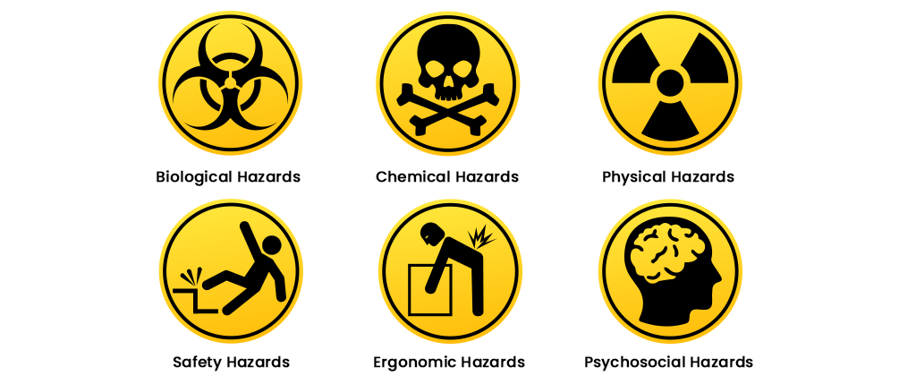
Hazards in the WTP
Hazards in the plant include but are not limited to:
Slip, Trip, and fall hazards
Spinning Shafts from electric motors to pumps
Electrical Hazards
Chemical Hazards
Confined Spaces
Drowning in a basin
Sparks and kick-back from cutting tools
Heavy Equipment
Contents under pressure
Pathogens and microorganisms.

Slide 126
Hazards in the WTP
Always ensure there are no hoses, silt, or blockages in commonly traveled walkways
Never hop into a confined space without using a meter to ensure there is adequate oxygen and no volatile gases trapped in the confined space
Never walk underneath of equipment being operated or anything large machinery such as a pump being lifted with a chain fall

Slide 127
Chemical Hazards
Some chemicals in the plant are in a concentrated solution. This means they are mixed stronger and meant to be added in small quantities to the finished product. If these chemicals touch your skin, it can cause irritation or burns.
Chemicals like Potassium Permanganate come in a powder form. Always use dust shields, or respirators when handling these chemicals to prevent them getting into your lungs.
Fun Fact: a 50/50 solution of white vinegar and hydrogen peroxide will remove the purple from your skin caused by permanganate.

Slide 128
Chemical Hazards
Other Chemicals such as Sodium Bisulfite put off very volatile fumes and can quickly incapacitate you.
Be sure to read the SDS sheet for all the chemicals you will use at your specific plant and remain safe using the information available on that sheet.

Slide 129
General Hazards
During your work, you will probably come into contact with power tools
If you are unfamiliar on how to operate ANY tool, do not hesitate to ask. As an intern you are here to learn and STAY SAFE
DO NOT JUST WING IT, YOU WILL GET HURT

Slide 130
General Hazards
You will often times use gas powered generators or trash pumps
When working with gasoline, be sure there are no spills especially near drinking water or fire hazards
One single gallon of gasoline can contaminate up to ONE MILLION gallons of water

Slide 131
General Hazards
You are the first line of defense for your communities drinking water supply. Act Accordingly.
An example:
If you must step down into a filter bed, use isopropyl alcohol to disinfect your boots, any tools going in, and any other means that contamination could be introduced to the media.

Slide 132
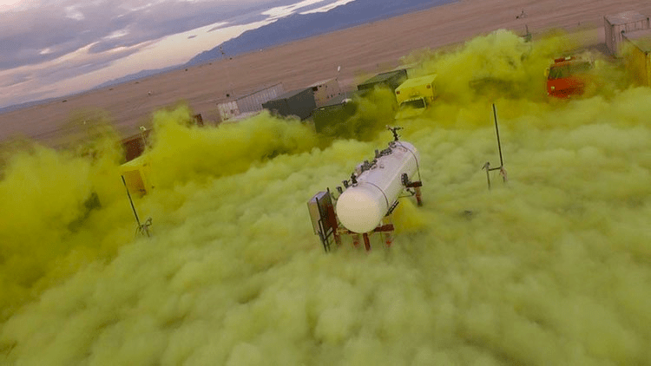
Chlorine Gas
If your plant uses Chlorine Gas, take extra precaution when doing ANYTHING that involves it
Chlorine Gas was used as a chemical weapon in WW1
Chlorine Gas is heavier than air, therefore sinks in open atmosphere
Chlorine Gas is a powerful oxidizer and causes rust formation on metals it comes into contact with

Slide 133
Chlorine Gas
Because of the safety hazards imposed with chlorine gas it is stored in a separate room from other operating areas.
These rooms have the following qualities:
Shatter Resistant Inspection Windows
Located on the interior walls are constructed in a way that the opening between the chlorine room and the plant is sealed.
Doors equipped with panic hardware that provide an exit only to the exterior of the building
Ventilation fans designed specifically for chlorine gas
These fans must provide adequate flow to provide one full aur change in the room in one minute.
These fans are installed near the floor as chlorine gas is heavier than air
Installed as practically feasible from door and air intake.
Signal light indicating fan operation

Slide 134
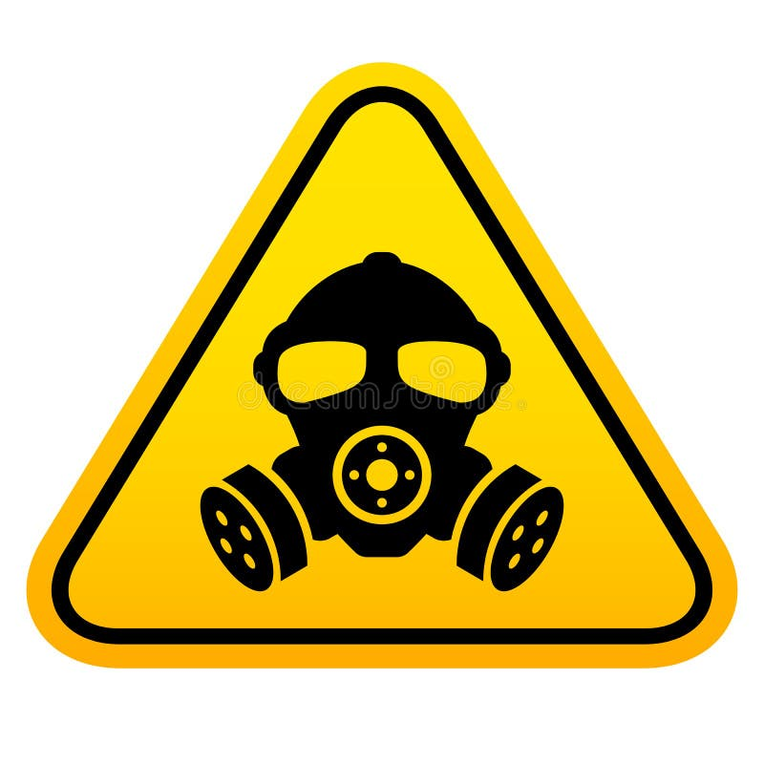
Chlorine Gas
If there is a chlorine gas leak:
Call 911 and inform dispatch that it is a chlorine gas leak
DO NOT attempt to resolve the leak
Professionals with appropriate PPE and training to deal with these circumstances will rectify the problem
If there is someone unconscious from a chlorine leak, DO NOT ATTEMPT TO RETRIEVE THEM! YOU CAN AND WILL BE INJURED AS WELL!

Slide 135
Chlorine Gas
The best method to remain safe around chlorine gas is:
Understand the equipment you are using
Move slowly, and methodically
Check for leaks when changing a cylinder with Anhydrous Amonia
Always have a partner with you to help
Ask questions and ensure your safety when dealing with dangerous chemicals

Slide 136
Chlorine Gas
Chlorine Gas is fed via a vacuum regulator
This means using a venturi principal there is a vacuum necessary to allow the gas to escape via the regulator to be fed in the lines
When disconnecting a Vacuum Regulator it is important to “Evacuate” Chlorine Gas still remaining in the lines before disconnecting anything!

Slide 137
Chlorine Gas Cylinder Changeout
The first step in changing chlorine cylinders is to identify which cylinder needs changing.
It is good technique to write install dates in chalk on the side of cylinders to identify which cylinder has been in service the longest.
In the configuration to the right, both cylinders sit on two separate scales which makes identifying the empty cylinder much easier.

Slide 138
Chlorine Gas Cylinder Changeout
Once you have identified the cylinder needing to be changed, you must evacuate the remaining chlorine gas in the lines
The way to do this is to shut the valve on the cylinder, which in this configuration is marked with a red arrow
Using the wrench, turn the valve to the right shutting it off completely
The vacuum from the injector will suck the remaining chlorine gas out of the regulator

Slide 139
Chlorine Gas Cylinder Changeout
Next, You will want to shut the valves where the chlorine is injected into the water
These are most commonly next to the device known as the “Injector”

Slide 140
Chlorine Gas Cylinder Changeout
When you have ensured the cylinder is shutoff, the lines have been evacuated, and the injector valves are closed:
You may now remove the Vacuum Regulator from the cylinder. This is done by loosening the screw from the cylinder marked with an arrow.

Slide 141
Chlorine Gas Cylinder Changeout
Once loosened, ensure that you remove the old lead washer from the regulator.
Safely swap cylinders and place a new washer (Flat side goes against the regulator) on the vacuum regulator.
Retighten the regulator back onto the cylinder and prepare to put back into service

Slide 142
Chlorine Gas Cylinder Changeout
In a very short burst, open the valve on the cylinder and shut back off
Take a bottle of Ammonia and check the points marked with arrows. Ensure there are no leaks
Check all fittings, especially where the lead gasket is

Slide 143
Chlorine Gas Cylinder Changeout
Once you are 100% certain there are no leaks, place the cylinder in service by opening the injector valve, opening the valve on the cylinder, and placing the vacuum regulator on standby/in service mode.
Remember: Chlorine gas will cause death! Be very cautious when handling this chemical specifically

Slide 144
Group Discussion
Would you drink this glass of water?
Do you think this is safe to drink

